Slide 1
Naïve Bayesian Classifier
The Naive Bayesian classifier is based on Bayes’ theorem with independence assumptions between predictors. A Naive Bayesian model is easy to build, with no complicated iterative parameter estimation which makes it particularly useful for very large datasets. Despite its simplicity, the Naive Bayesian classifier often does surprisingly well and is widely used because it often outperforms more sophisticated classification methods.

Slide 2
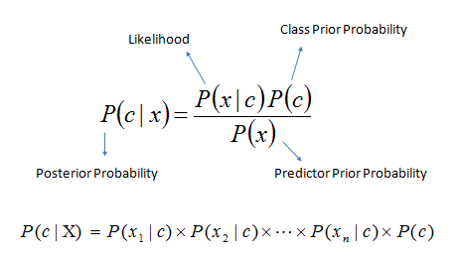
Algorithm
Bayes theorem provides a way of calculating the posterior probability, P(c|x), from P(c), P(x), and P(x|c). Naive Bayes classifier assume that the effect of the value of a predictor (x) on a given class (c) is independent of the values of other predictors. This assumption is called class conditional independence.
P(c|x) is the posterior probability of class (target) given predictor (attribute).
P(c) is the prior probability of class.
P(x|c) is the likelihood which is the probability of predictor given class.
P(x) is the prior probability of predictor.

Slide 3
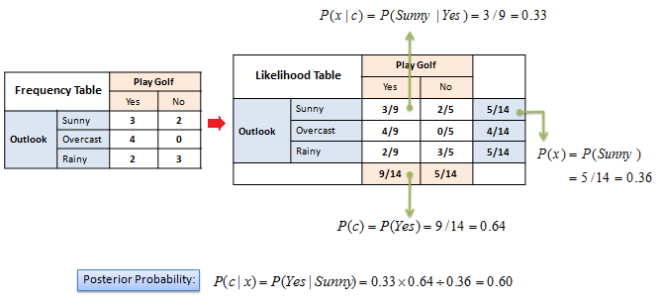
Example:
The posterior probability can be calculated by first, constructing a frequency table for each attribute against the target. Then, transforming the frequency tables to likelihood tables and finally use the Naive Bayesian equation to calculate the posterior probability for each class. The class with the highest posterior probability is the outcome of prediction.

Slide 4
The zero-frequency problem
Add 1 to the count for every attribute value-class combination (Laplace estimator) when an attribute value (Outlook=Overcast) doesn’t occur with every class value (Play Golf=no).
Numerical Predictors
Numerical variables need to be transformed to their categorical counterparts (binning) before constructing their frequency tables. The other option we have is using the distribution of the numerical variable to have a good guess of the frequency. For example, one common practice is to assume normal distributions for numerical variables. Also if the continuous variable is not normal then you need to transform it to follow normal distribution

